Slide 1

Hand Sign Detection using Computer Vision
Name: K. Sanjay Kumar
Batch No : 436
Innomatics Research Labs
Dilsukhnagar

Slide 2
About me:
Hello, I’am Sanjay Kumar,
I’am have been recently graduated from Computer Science and Engineering Data Science from Vignana Bharathi Institute Of Technology.
I’am passionate about analyzing data to solve real-world problems and excited to combine programming, statistics, and machine learning to extract meaningful insights.
LinkedIN: www.linkedin.com/in/sanjay-kumar-0112ab31a
Github: https://github.com/sanjay3603

Slide 3
Introduction:
Hand sign recognition is an important technology for improving communication accessibility.
This project focuses on detecting and recognizing A–Z hand gestures in real time using computer vision and deep learning.
The system processes live webcam input and displays the predicted alphabet clearly to the user.
In this Project we are going to use CRISP-ML(Q) Methodology.

Slide 4
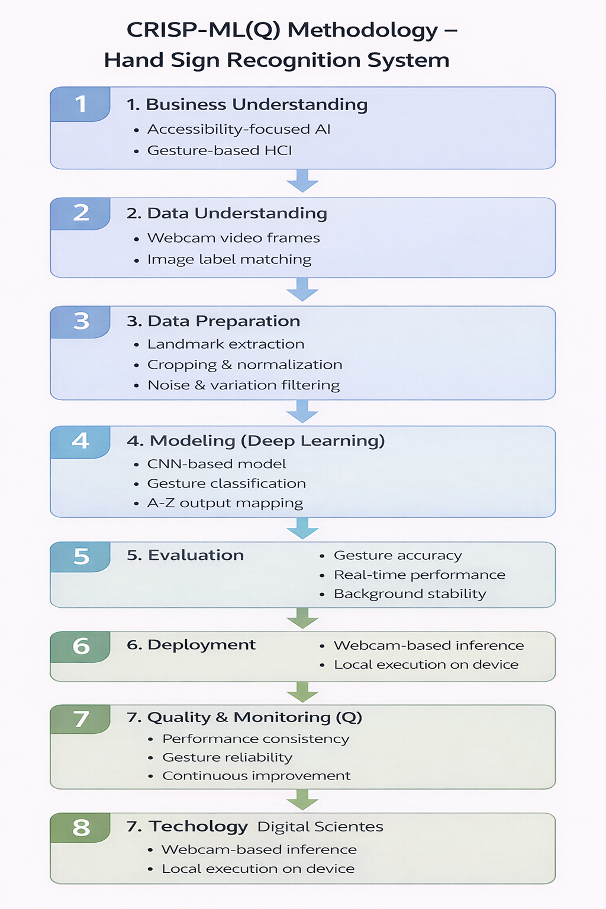
CRISP-ML(Q) Methodology :

Slide 5
Business Problem :
Communication barriers remain a major challenge for individuals who rely on hand signs or sign language.
Most people and digital systems are not equipped to understand hand gestures, limiting effective interaction.
There is a growing need for an intelligent, real-time solution that can automatically recognize and interpret hand signs to improve accessibility and human–computer communication.

Slide 6
Project Objective :
To design and implement a real-time hand sign detection system using computer vision techniques
To accurately recognize A–Z hand gestures from live webcam input using a trained deep learning model.
To support accessibility and intuitive human–computer interaction through gesture-based recognition.

Slide 7
Project Focus :
Design and develop a real-time hand sign recognition system using computer vision and deep learning.
Accurately identify A–Z hand gestures from live webcam input through preprocessing and classification.
Ensure clear visual feedback, stable performance, and usability for accessibility-focused applications.

Slide 8
Technologies Used :
Python :
Used as the core programming language for developing the entire hand sign detection system.
Handles data processing, model integration, and overall application control.
OpenCV :
Used to access the webcam and capture real-time video frames.
Also responsible for image preprocessing, drawing bounding boxes, and displaying prediction results.
MediaPipe :
Used for real-time hand detection and extraction of hand landmark points.
Provides accurate and efficient hand tracking required for gesture recognition.
CVZone :
Used as a high-level wrapper over MediaPipe to simplify hand tracking and bounding box extraction.
Helps reduce code complexity and improves development speed.
TensorFlow / Keras :
Used to build and load the classification model.
Performs hand sign recognition by predicting alphabets from processed images.
Summary :
These technologies work together to enable accurate, real-time hand sign detection and alphabet recognition using computer vision.

Slide 9
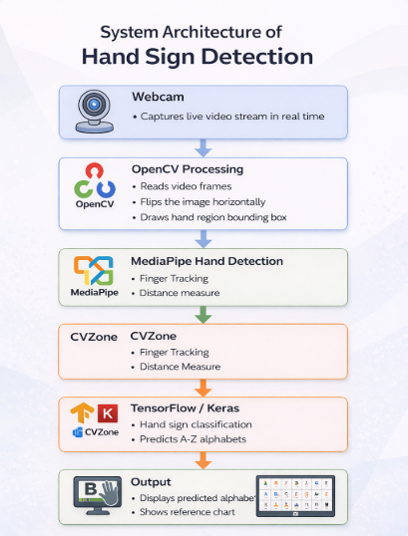

Slide 10
System Architecture :
Live video stream is captured using a standard webcam for real-time processing.
MediaPipe-based hand detection identifies the hand region and extracts bounding box coordinates.
The detected hand is cropped, resized to a fixed dimension (300×300), and normalized for consistency.
A trained CNN (Keras .h5 model) classifies the preprocessed image into one of the A–Z hand sign classes.
The predicted alphabet is displayed clearly on the live video feed along with a reference hand sign chart.

Slide 11
Hand Sign Detection Working :
  Input Capture:
  A webcam continuously captures live video frames of the user’s hand gestures.
  Hand Detection & Cropping:
  MediaPipe-based hand tracking detects the hand and extracts the region of interest (ROI).
  Preprocessing:
  The cropped hand image is resized, centered, and normalized to a fixed input size (300×300).
  Model Inference:
  The preprocessed image is passed to a trained deep learning (CNN) model for classification.
  Output Display:
  The predicted alphabet (A–Z) is displayed in real time with a clear visual overlay.

Slide 12
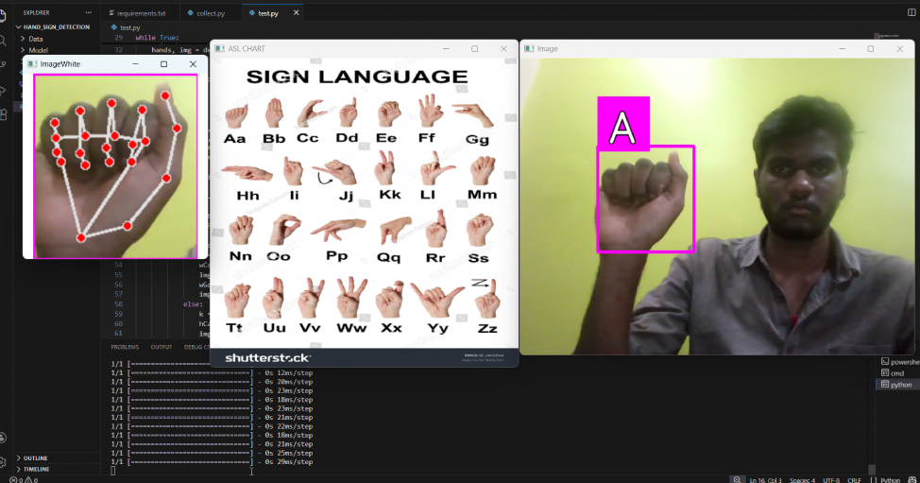
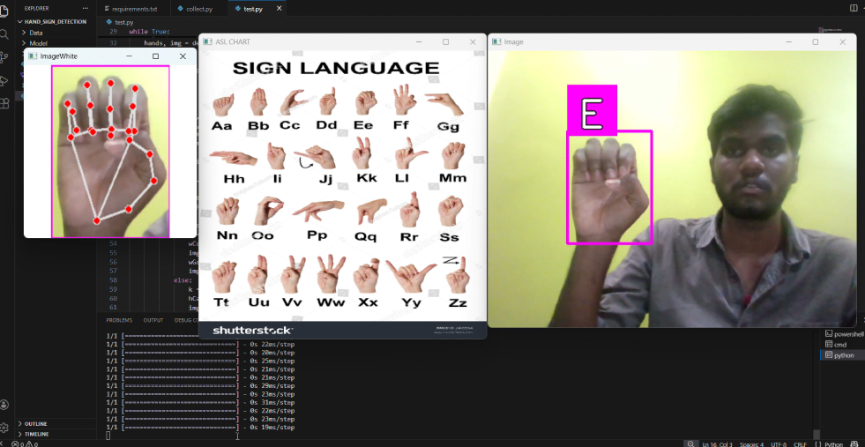
Output :

Slide 13
Key Features :
Real-time hand gesture recognition using webcam input.
Accurate detection of A–Z hand signs through deep learning.
Hand region cropping and normalization for consistent predictions.
Clear visual feedback with bounding box and predicted label.
Reference chart displayed for user guidance and learning.

Slide 14
Challenges Faced :
Similar hand gestures causing misclassification between letters
Sensitivity to lighting conditions and background noise.
Dataset imbalance across different alphabets.
Model compatibility and environment dependency issues.
Maintaining real-time performance with accurate predictions.

Slide 15
Applications :
Assistive communication tools for speech and hearing-impaired users.
Interactive learning platforms for sign language education.
Gesture-based human–computer interaction systems.
Accessibility solutions in healthcare and public services.
Foundation for advanced AI-based communication interfaces.

Slide 16
Conclusion :
Successfully implemented a real-time hand sign detection system.
Demonstrated effective use of computer vision and deep learning.
Improved understanding of model training and deployment workflows.
Highlighted AI’s potential in accessibility-focused applications.
Provides scope for future enhancements and real-world deployment.

Slide 17

THANK YOU

